Slide 1
REVIEW OF LESSON 2
5 types of informative presentations
Eight elements of the introduction

Slide 2

Last week’s assignment
Plan and write the script for the introduction to introduce HCMC International University. Your audience are:
High school students considering IU as a choice

Slide 3
Sample Introduction – Topic 1
Topic: IU
Type:
Organization:
Audience:
Preview:
Programs and teaching quality
Tuition and financial aids
Extracurricular activities
Object
Topical
High school students

Slide 4
IU - Second Home for High School Leavers
Greeting: Hello everyone. Thank you for spending your time coming here to our presentation.
Self-introduction: We Rose Group with 4 members are all sophomores at International University (or IU for short), which is one of seven member institutions of Vietnam National University, HCMC.
Attention-getter: It’s obvious that choosing a suitable university to enroll is crucially important and might take us lots of time to make a decision. Do you want to learn in an academic but comfortable environment? Do you want to experience a friendly university atmosphere? The answer is definitely Yes, right?
Topic connection: We’re sure that all of you here have thought about these criteria when you cross the threshold into college life. If you are still unsure of which university or college you should apply to, we are willing to introduce you to our ‘second home’ where we have lived for one year.
Credibility: We hope that our authentic experience at IU will give some useful information so that you can make up your mind with confidence.
Preview: Our talk will be divided into three points. First, we’ll provide some basic information about programs and teaching quality at IU. After that, we’ll discuss the topic of tuition and financial aids. Finally, we’ll cover the extracurricular activities because you cannot always work without relaxing, right?
Rule for Q&A: If you have any questions, feel free to ask us when we finish.
Transition: Now, let us begin the first part: what IU can offer you academically.

Slide 5
Sample Introduction – Topic 2
Topic: IU
Type:
Organization:
Audience:
Preview:
Names of clubs
Typical activities
Upcoming events
Object
Topical
K23 IUers

Slide 6
FUN CORNERS AT IU
1. Greeting and saying thank-you: Warm welcome to IU freshmen and big thanks for joining us today.
2. Introducing yourself: We are IU Ambassadors, representing IU seniors to introduce our university to you all, new members of our family.
3. Getting the audience’s attention: How much have you discovered about IU before coming here today? I guess all of you have heard about IU food court, or IU mascot Koi fish when visiting the IU Confessions fan page, right?
4. Connecting the topic to the audience: However, we think that there are many things you haven’t known about IU, and that’s why we are here today to bring you to the fun corners in our lovely family.
5. Establishing credibility: As senior students from different schools and departments at IU, we have experienced many extracurricular activities for the past few years, that’s why we’re confident we’ll take you all on the right path.
6. Providing a preview: Our talk today will be divided into three parts. First, we’ll introduce various clubs at IU so that you can make your choice. Second, we’ll describe the main activities that these clubs usually hold. Finally, we’ll highlight some upcoming events for your first experience.
7. Setting the time for Q&A: We’ll take about 5 to 6 minutes of your time. If you have any questions, feel free to ask us when we finish.
8. Transitioning to the body: Ok, we won’t keep you waiting anymore. Let’s begin with the fun corners here and there on our campus.

Slide 7
LESSON THREE
SUPPORT

Slide 8
SUPPORTING YOUR TOPIC
TOPIC
Point 1
….
Point 2
….
Point 3
….
The Topic will be developed into three points, which are presented clearly in the Preview (element 6) of the Introduction.

Slide 9
HCM International University Second Home for High School Leavers
Preview:
Programs and teaching qualities
Tuition and financial aids
Extracurricular activities
Notes:
When you work on a TOPIC, follow the steps as in the sample:
Identify the type of Informative Presentation
Choose a relevant organization
Select an impressive TITLE so that the audience can expect your contents. Bear in mind that the TITLE is different from the TOPIC: it is a phrase that catches the audience’s interest.
Preview: Three points are in a parallel structure. As in this sample, the three points are three noun phrases. The points must focus on what the audience need to know about the topic. In your assignment, you talk to an audience that has NEVER known about Covid-19 before. Therefore you have to go from the its origin. So far, we are still not sure about where the virus comes from, so we must say ‘assumed origin’. Points 2 and 3 are relevant to the type of Issue.

Slide 10
Outline exercises for Support
Task: Put the numbers on the left into the structure tree on the right to have relevant support for each point.

Slide 11
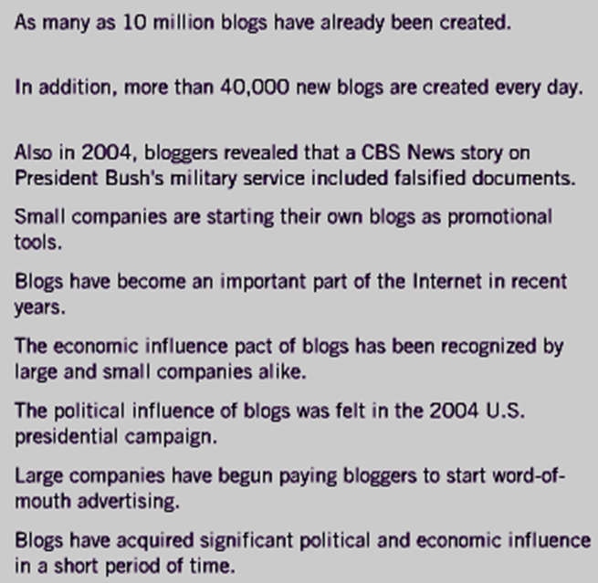
1
I
A
B
II
A
B
C
1
2
2
3
4
5
6
7
8
9
Notes:
Note: Pay attention to the logic to work out their order.

Slide 12
1
I
A
B
II
A
B
C
1
2
5
1
2
3
2
4
9
7
5
6
3
7
6
8
8
9
4
Notes:
Pay attention to the logic:
1 and 2 both support I, but we cannot arrange 2 and 1 due to the word ‘Also’
II mentions ‘political and economic’, so A must be about ‘political’ and B is about ‘economic’.
7 comes before 3 because of ‘Also’
8 comes before 4 because of the logic of ‘large and small’ in 6
Techniques of support:
1 + 2: statistics (these statistics are not very reliable because no sources are citied)
7 + 3: examples (no sources cited)
8 + 4: facts

Slide 13
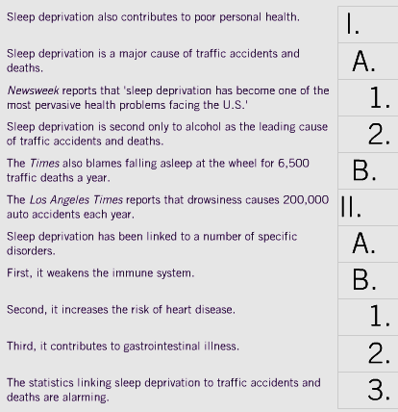
1
2
3
4
5
6
7
8
9
10
11

Slide 14
1
2
2
11
3
6
4
5
5
4
6
1
7
3
8
7
9
8
10
9
11
10
Notes:
Techniques of support:
- 6 + 5: statistics
3: Testimony: a famous person’s opinion or a popular organization’s statement.
8 + 9 + 10: facts
In this exercise, all the statistics and testimony are cited from trustworthy sources. As a result, the support in this exercise has more credibility than it is exercise 1.

Slide 15
Three ways to support your points:
Techniques for Support
Examples
Statistics
Testimony

Slide 16
1. Tips for Using Examples
To clarify and/or reinforce ideas
To personalize ideas
e.g. You reap what you sow.
To clarify: A lemon tree -> lemons, not oranges
To personalize: Your own situation
Notes:
When you select an example, remember it has to be specific.
The concept ‘You reap what you sow’ means ‘You get what you give’. When you have a specific example of growing a lemon tree you get lemons, your audience can understand you more easily.

Slide 17
Types of Examples
1. Brief examples
Easy to understand, mentioned only once
2. Extended examples
Narrative example to make the abstract idea very clear
3. Hypothetical examples
Put the audience in imaginary situations, so that they can ‘feel’ more

Slide 18

Which type of example?

Slide 19
Which type of example?

Slide 20
Types of Examples
Task. Give three examples to clarify the situation
K22 IUers’ eagerness for the first day to class
1. Brief examples
Newbies are asking around for buses, dress code, PE uniform.
2. Extended examples
An IUer’s detailed story about the first day to IU.
3. Hypothetical examples
Imagine you wake up on October 10th, get smartly dressed for IU, catch the bus, drop off and stop by the food court. ☺ ☺ ☺

Slide 21
2. Using statistics

Slide 22
Tips for Using Statistics
Use statistics sparingly
Identify the sources of statistics
Explain statistics meaningfully
Round off complicated statistics
Use visual aids to clarify statistics
Notes:
‘sparingly’ means just now and then, not too frequently. Numbers, especially long numbers, are difficult to remember when you hear, not read.
Important: ALWAYS PROVIDE SOURCES to add credibility to your statistics. Otherwise, your audience may assume you make them up.
If possible, you can link the number to a subject that is more familiar to the audience. For example, when you talk about the Bitexco Financial Tower (69 floors) for an IUer first coming to HCMC and has never seen Bitexco before, you can say ‘Bitexco is about 10 times higher than IU building’.
When presenting, you don’t need and shouldn’t give the exact numbers which are hard to remember. Round them off instead. For example. 3,471 -> about 3,500
Charts, tables… are required for complicated numbers.

Slide 23
3. Using expert testimony

Slide 24
Tips for Using Testimony
Quote or paraphrase accurately
Use testimony from qualified sources
Use testimony from unbiased sources
Identify the people you quote or paraphrase
Notes:
Citing a person or an organization’s opinion requires the same regulations accuracy, sources, fairness, and acknowledgement.

Slide 25
Assignment: Provide support for ONE POINT only.
Topic: IU CULTURE
Type:
Organization:
Audience:
Preview:
Elevator etiquette
IU liberal style
IU foodcourt
IU mascot – Koi
Concept
Topical
IU newbies

Slide 26
Assignment: Provide support for ONE POINT only.
Instructions:
1. Use 3 types of support:
- Examples
- Statistics
- Testimonies
2. Write three supporting details for ONE POINT.
3. Underline and indicate the techniques of support (at least one for each technique).
4. Cite the sources.
5. Be playful and friendly.

Slide 27
WHEN IN IU, DO AS IUERS DO
Greeting: Hello everyone. Thank you for joining our friendly talk today.
Self-introduction:
Attention-getter:
Topic connection:
Credibility:
Preview: Our talk will be divided into three parts. First, …
Rule for Q&A: If you have any questions, feel free to ask us when we finish.
Transition: Now, let us begin the first part:….

Slide 28
YOUR GROUP’S POINT
Transition:
Develop your point with:
- Example
- Statistic
- Testimony

Slide 29
Link to submit
https://drive.google.com/drive/folders/1jSGURyiGQUFUzMz2RPQJwJXNncNMglAm?usp=sharing

